Slide 1
Seniors Engagement Through Technology
Sub-Initiative by PICS, under SISSIP Network

Slide 2
Vision
Is an initiative dedicated to educating and supporting seniors in use of technology to enhance social connections and engagement within the community and their personal network.
The focus of SETT is to ensure seniors receive accessible technology support and training that is inclusive and simplified for their understanding.

Slide 3
CCAARRTT Barriers Addressed
Technology – teaching technology to seniors, ranging from basics to intermediate levels
Awareness – technology progression till date, related terminologies , devices and applications
Cultural Connections – participants from across cultures during, and exchange of cultural insights during engagement sessions particularly
Recreation – sessions act as not only a medium of learning new skills but also as a recreational platform, giving a boost to your mental & physical health

Slide 4
Highlights
Learn new digital skills seniors can instantly apply everyday
1-month classes providing practical knowledge of Computers and Internet
Multi-lingual program delivered in English, Hindi & Punjabi
Course designed by experts to facilitate easy learning
Eligibility Criteria: Senior Citizens (55 yrs+), residents of Surrey

Slide 5
Ipad Loaning Program
Seniors can also receive hardware (iPads) through a loaning program to be able to participate in the project, who otherwise might not have resources to do so.
Initially loaned for 6 months, which can be further extended to another 6 months
No charges applicable for the ipads

Slide 6
Course Structure
Week | Date | Time | Topics
Week 1 | Monday | 10:00 AM – 12:00 PM | Basics of Computers/Laptops , Learning & Creation of Gmail Id’s
 | Wednesday | 10:00 AM – 12:00 PM
 | Friday | 10:00 AM – 12:00 PM
Week 2 | Monday | 10:00 AM – 12:00 PM | Internet Browsing , Tablets & Phones Features
 | Wednesday | 10:00 AM – 12:00 PM
 | Friday | 10:00 AM – 12:00 PM
Week 3 | Monday | 10:00 AM – 12:00 PM | Mobile Learning & the know-how of Apps
 | Wednesday | 10:00 AM – 12:00 PM
 | Friday | 10:00 AM – 12:00 PM
Week 4 | Monday | 10:00 AM – 12:00 PM | Information about popular Apps for Seniors Learning to Social Media such as – Facebook, Whats App, Instagram etc.
 | Wednesday | 10:00 AM – 12:00 PM
 | Friday | 10:00 AM – 12:00 PM
Week 5 | Monday | 10:00 AM – 12:00 PM | Learn to set up Zoom Meetings to connect with family & friends
 | Wednesday | 10:00 AM – 12:00 PM
 | Friday | 10:00 AM – 12:00 PM

Slide 7
Cohort Phases
Engagement Sessions
Pre – Sessions
Planning for Cohort/Sessions
Content Designing
Marketing /Communication
Addressing of Enquiries & Filling of Intake Form
Helping seniors download Zoom Application
Setting up of Zoom Meeting & Link Generation
Registration Confirmation & Welcome Email along with session joining details
During Sessions
Sessions starts 15 minutes prior to ease off joining process and address participants queries
Facilitation of content for 2 hrs at a pace and language suitable to seniors
Revision of prior session content from ^{2nd} session onwards
Addressing of queries from pre-session
Post-Sessions
Sharing sessions recording links, for recollection and practice
Reminder of session each time with joining details, to aid convenience
Feedback form from participants, providing insights of success stories & learnings
Courier the training material with gift cards for reference, as a token of appreciation

Slide 8
Engagement Sessions
Idea is to keep the seniors engaged and act as a recreational medium
Organise activities like tech quizzes, games, etc.
Also acts as a platform to raise their doubts around technology
Moderator also provides technology related updates
Frequency – twice a month

Slide 9
Communication Plan
Marketing of the initiative to reach out to the Target Audience – primary & secondary both
Marketing Channels
Internal Communication –PICS
SISSIP Partners – Monthly Newsletters, In-program promotion
Digital Media reach out – Facebook, Instagram, Linked In, Website etc.
Community Partners – Assisted Living Facilities, Retirement Homes, Long Term Care Homes, Independent Living etc.
Ads in Radio & Newspapers

Slide 10
Success Stories - Cohort 1
A group of 15 seniors participated in the cohort started on Dec 7,2020
Demographics
Age : 55 -75 yrs
Male -2 , Female – 13
Ethnicity – South Asian (All)
Content Delivery – Punjabi & English
Duration – 5 weeks

Slide 11
Feedbacks Form Excerpts

Slide 19
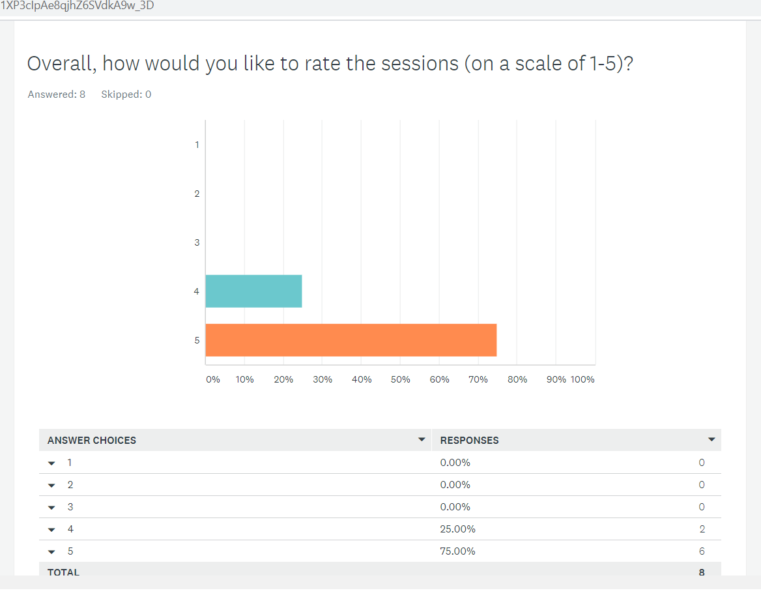

Slide 20
Inviting Feedbacks & Suggestions Thank You!

